Slide 1
Investigating Late Loan Payments Team 7
Isabella McCoy, Grady Smith, Abe Archer, and Kennedy Maloney
Notes:
Isabella

Slide 2
TABLE OF CONTENTS
01
02
03
OUR TEAM
OUR PROCESS
OUR CONCLUSIONS
Who we are
What we did
What we found
Notes:
Grady

Slide 3
OUR TEAM
Structure:
Met Mondays at 2:00 outside of class
Used areas of expertise to determine what types of test we ran and what we studied
Updated each other on progress after each presentation in class
Isabella McCoy: Final Editor – Paper
Grady Smith: Final Editor – Presentation
Abe Archer: Scribe
Kennedy Maloney: Team Lead
Key variables we examined
Isabella: installment, loan_amnt, funded_amnt
Grady: acc_now_delinq, out_prncp, annual_inc
Abe: Interest
Kennedy: dti, annual_inc, loan_amnt
Notes:
Grady

Slide 4
OUR PROCESS
EDA
Visualizing
PART 02
PART 04
PART 01
PART 03
Deeper Statistics
Storytelling
Notes:
Kennedy

Slide 5
Let's take a look...
OUR CONCLUSIONS
Across four different hypotheses, we found that there are factors the bank should and should not use to determine if a customer will be late on their payments. However, they are already on the right track.
Notes:
Kennedy

Slide 6
Hypothesis #1
Investigating the Interests correlation with other variables:
There will be a most prominent correlation installments and the amount of interest a customer a customer’s loan has.
I think Interest will hold the weakest correlation with annual income (Extreme values).
Notes:
Abe

Slide 7
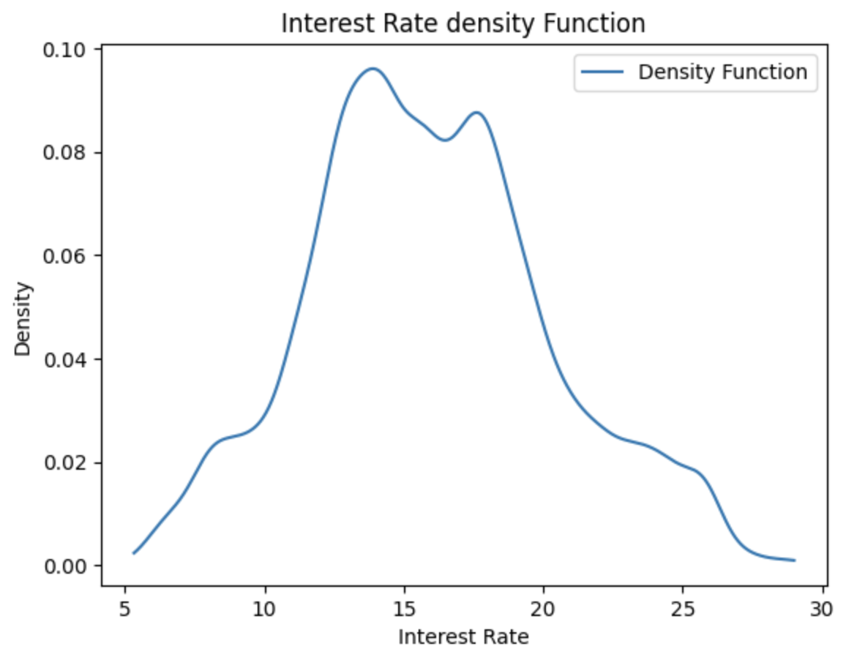
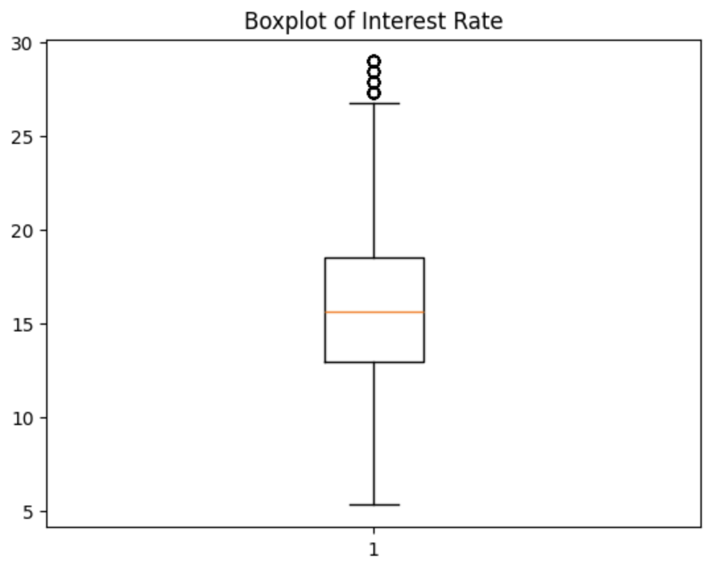
Interest EDA:
Density Distribution of Interest Rate
Mean Interest Rate: 15.95312
Max 28.99
Min 5.32
Notes:
Abe

Slide 8
ANOVA
Put most simply, ANOVA is a statistical analysis used to investigate the variance among variables.
In my case, I will be performing an ANOVA analysis on Interest and a target variables that I will compare it to.
I will be comparing the residual mean squared value.
Notes:
Abe

Slide 9
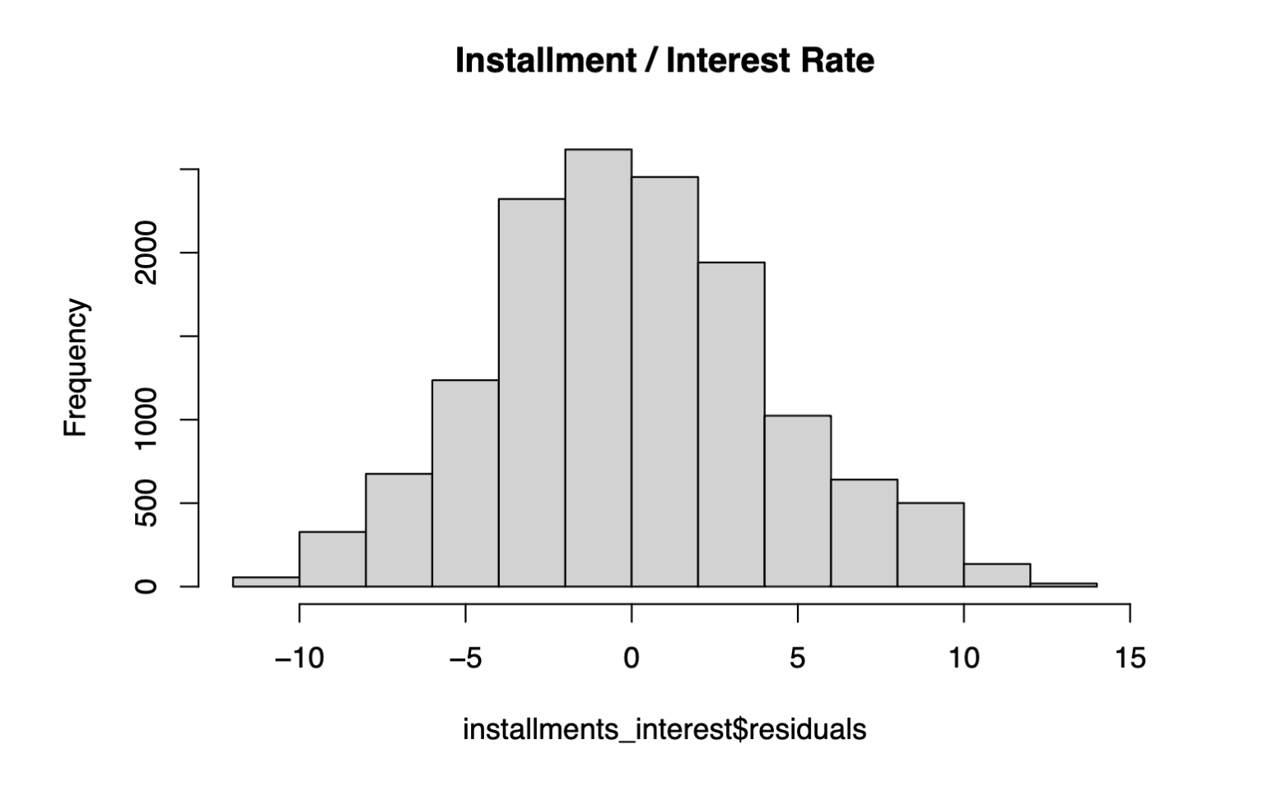
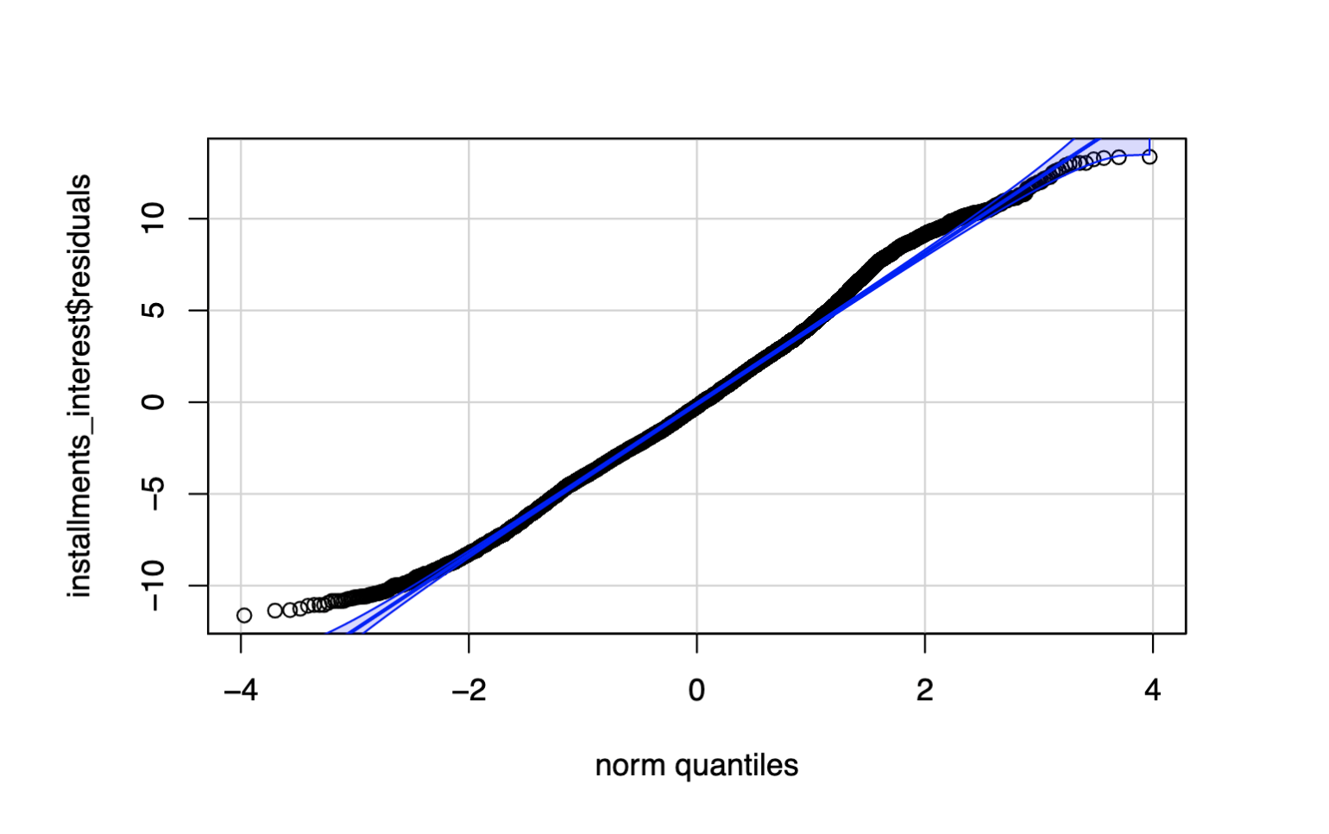
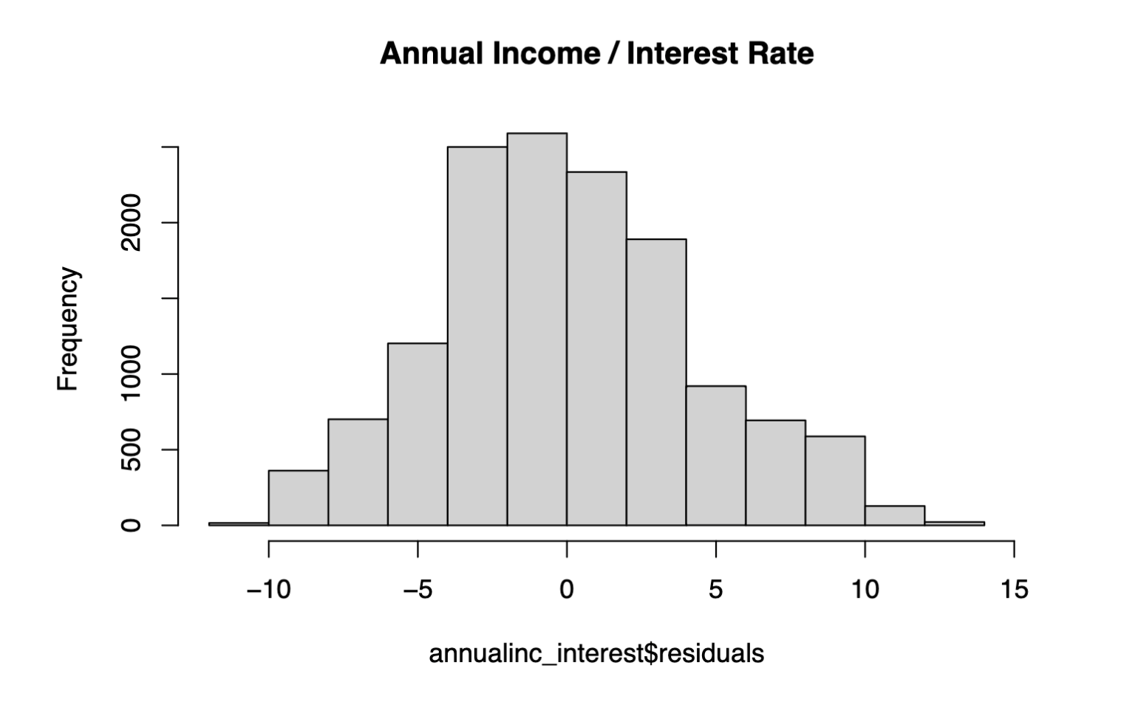
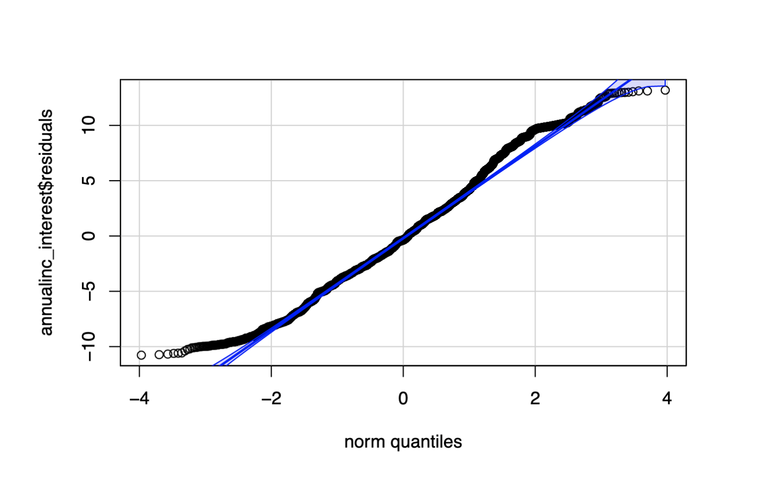
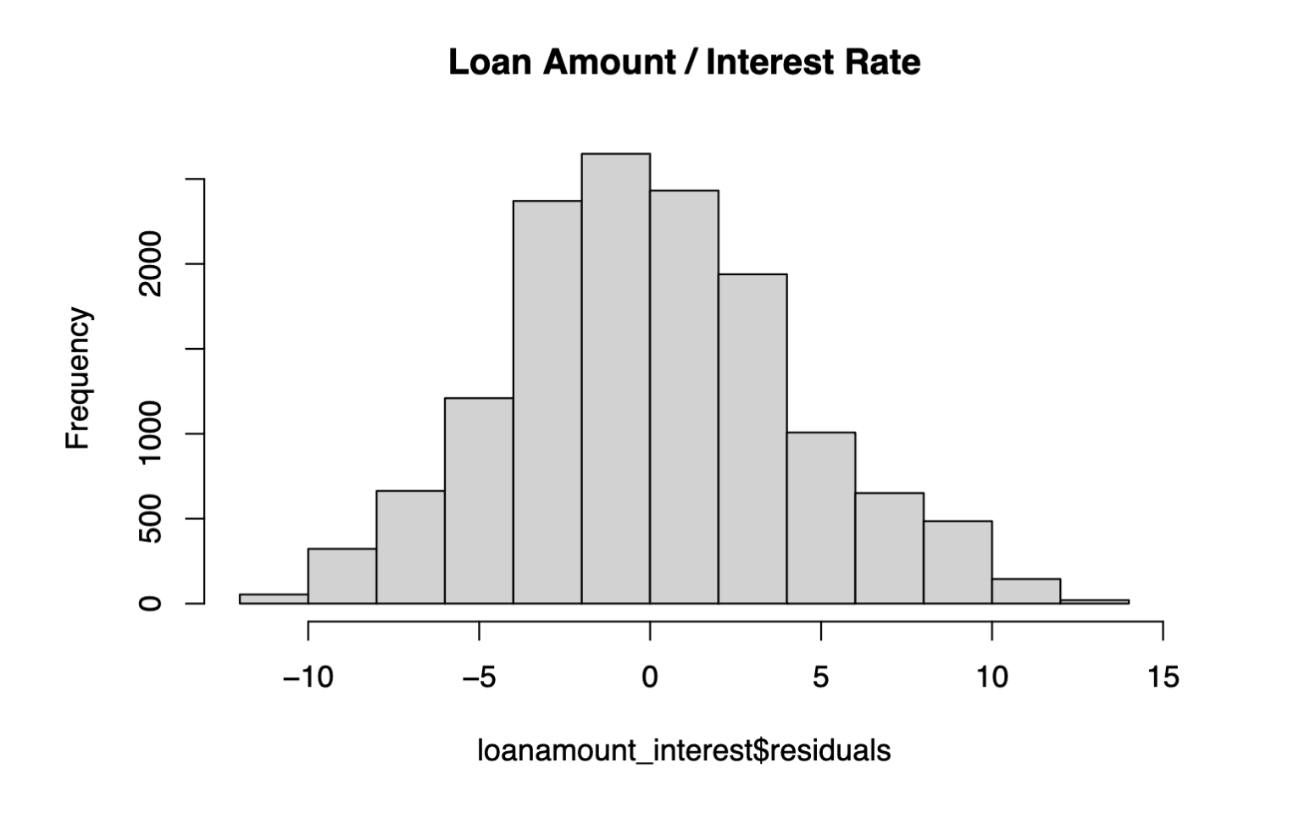
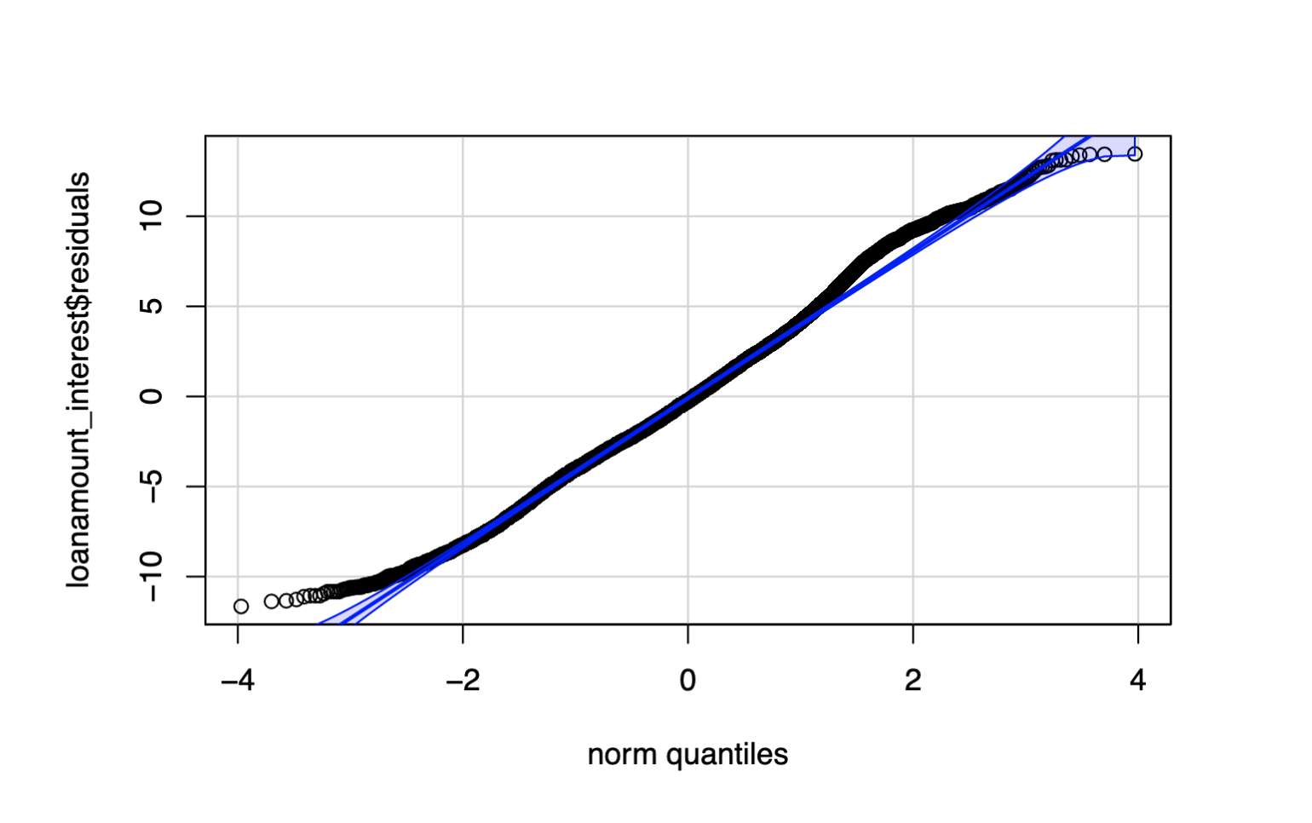
Installment
Residual Mean Squared: 18
Annual Income
Residual Mean Squared: 18.8
Loan Amount
Residual Mean Squared: 18
Notes:
Abe

Slide 10
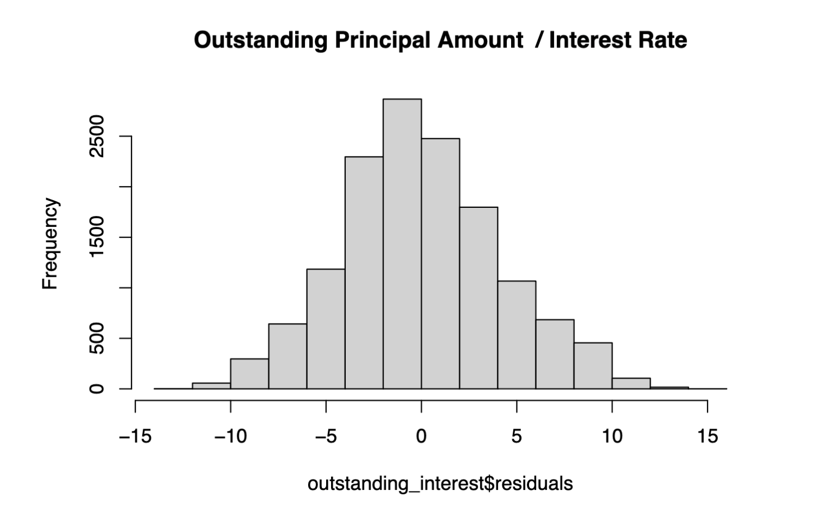
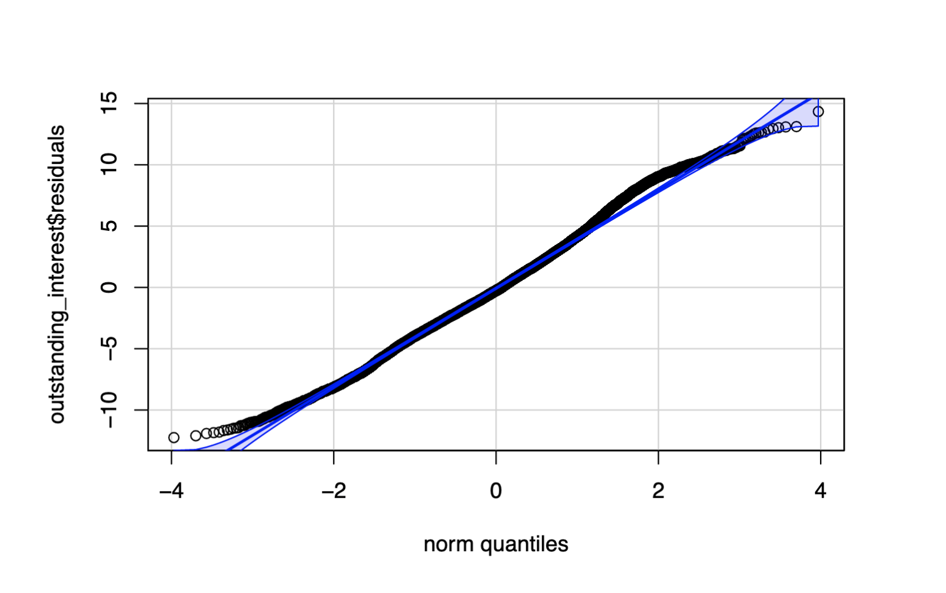
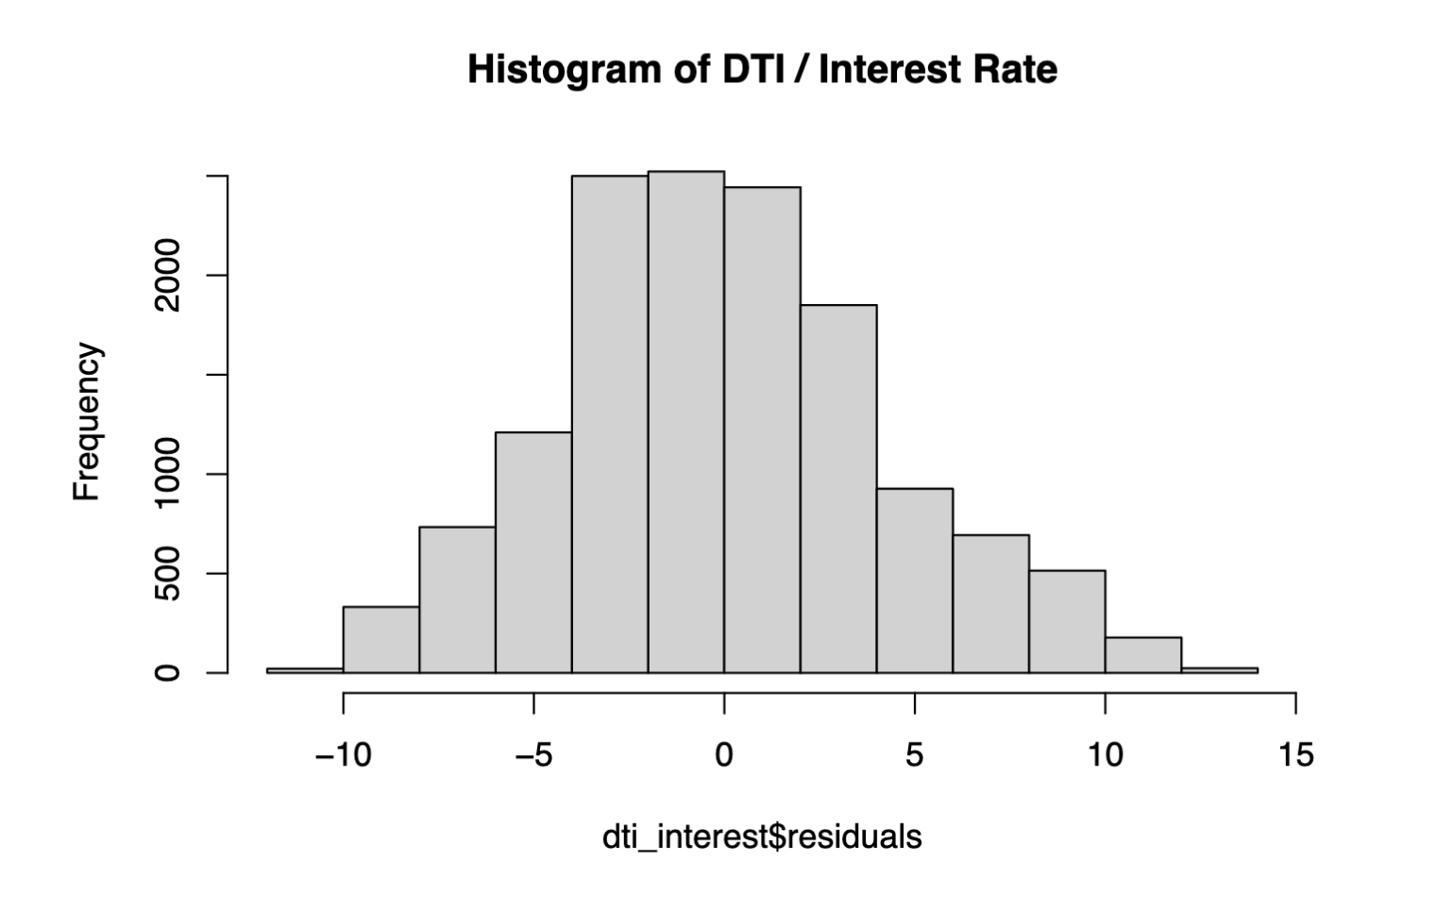
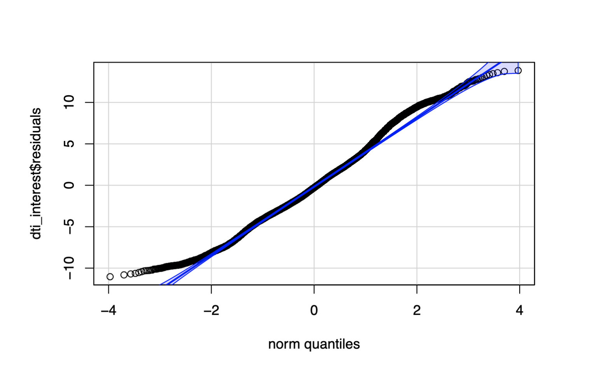
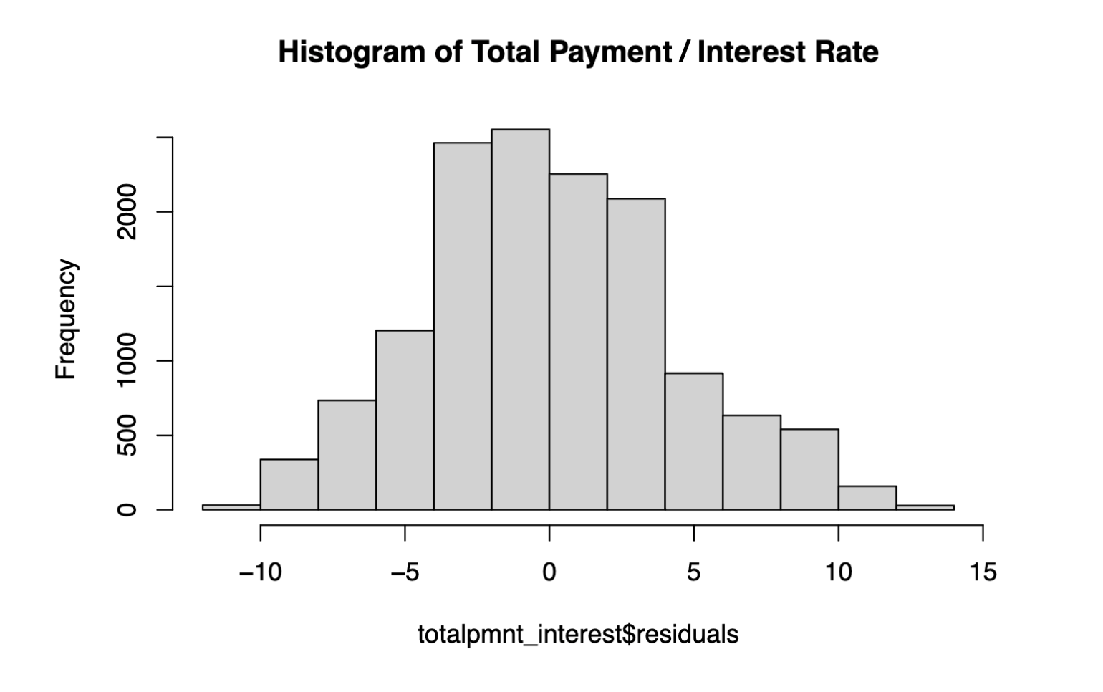

Outstanding Principal Amount
Residual Mean Squared: 17
DTI
Residual Mean Squared: 19
Total Payment
Residual Mean Squared: 19
Notes:
Abe

Slide 11
Hypothesis 1# Conclusions:
The variable with the highest correlation to interest was with Outstanding Principle Amount with a residual mean squared error value of 17, which did not follow my hypothesis.
The variable that had the lowest correlation to interest was the total payment and DTI (Debt to Income ratio), which both had a residual mean squared value of 19 which did not follow my hypothesis.
Notes:
Abe

Slide 12


Hypothesis #2
There will be a clear correlation between annual income and the amount of delinquent accounts for a customer.
There will be a clear correlation between annual income and remaining outstanding principle for total amount funded.
Income is a major predictor of financial responsibility for a prospective customer.
Notes:
Grady

Slide 13


Definitions
The definition of a delinquent account in banking, per several reliable banking resources, is an overdue account that has not received payment for over 30 days.
The remaining oustanding principle for total amount funded represents the amount of the original loan that still needs to be repaid.
Notes:
Grady

Slide 14


Income and Delinquent Accounts
Looking through our “late” dataset, there are 112 customers that have at least one delinquent account.
104 customers: 1 delinquent account $80,137.54
7 customers: 2 delinquent accounts $75,928.57
1 customer: 4 delinquent accounts $100,000
Overall, customers in this category have a higher average income than those not in this category within the dataset($80,051.82 vs $70,571.32).
The linear regression model suggests that there is a statistically significant relationship(p<.05), but the power of this information is limited considering the adjusted R-squared value is low.
Notes:
Grady

Slide 15
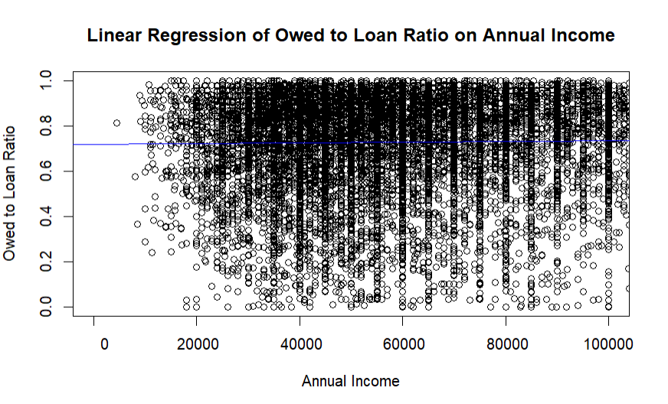
Notes:
Grady

Slide 16

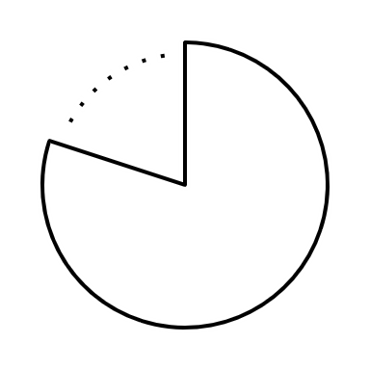
Income and Proportion Paid
Created a new column, outprncp_to_funded_amnt, that represents the ratio between remaining outstanding principal and funded amount.
After running a linear regression model on this column's relationship with income, we can conclude that the relationship is statistically significant, but annual income only explains a small amount of the variation in owed_to_funded_amnt.
Notes:
Grady

Slide 17
Hypothesis #2 Conclusion
Although income can be an insightful resource for predicting late customers credit behavior, it is not an overly extensive factor.
There are statistically meaningful relationships between delinquent accounts, proportion of the loan currently paid, and income. However, there is insufficient evidence to support a claim that income is a substantial predictor of a borrower’s responsibility.
Some other extraneous variables that can affect a consumer’s credit behavior:
Investment risks/Business ventures
Psychological factors
Notes:
Grady

Slide 18
Correlation Matrix
Using R, a correlation matrix was built to explore relationships between variables in the late payments dataset.
This matrix only includes values that had numeric data, and had an entry in every row.
Because of this, many variables were excluded.
The information gained from this matrix was then analyzed to explore specific correlations.
Notes:
Isabella

Slide 19
Hypothesis #3
Some variables, such as the total payment received and the total payment received that is funded by investors, will have a very strong correlation.
Correlations will be roughly similar for the late payments as they are to the full dataset.
Notes:
Isabella

Slide 20
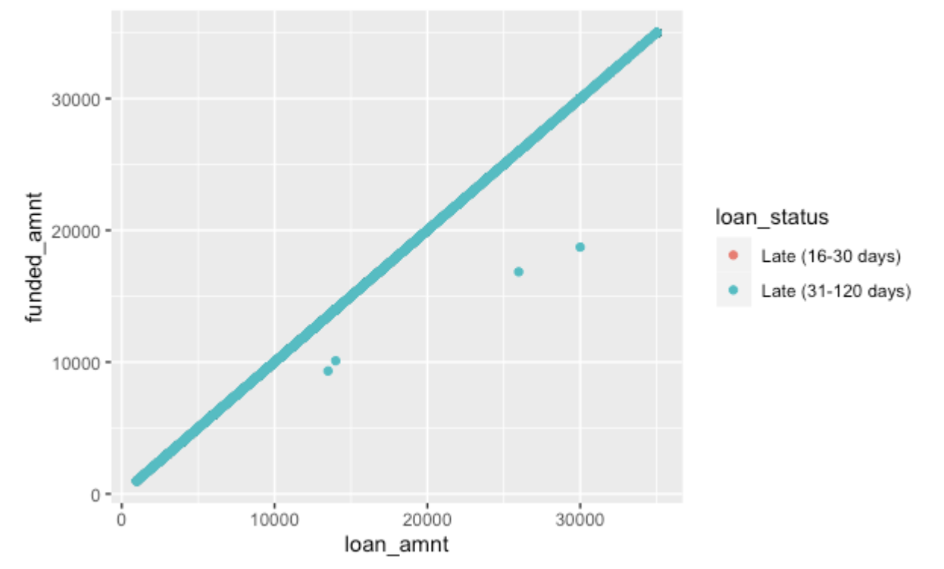
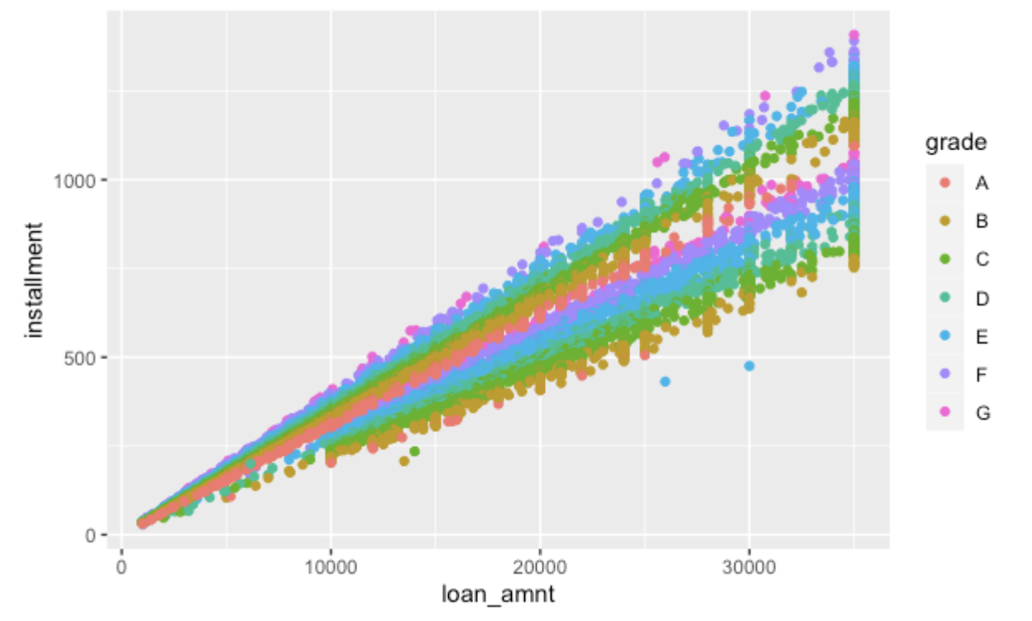
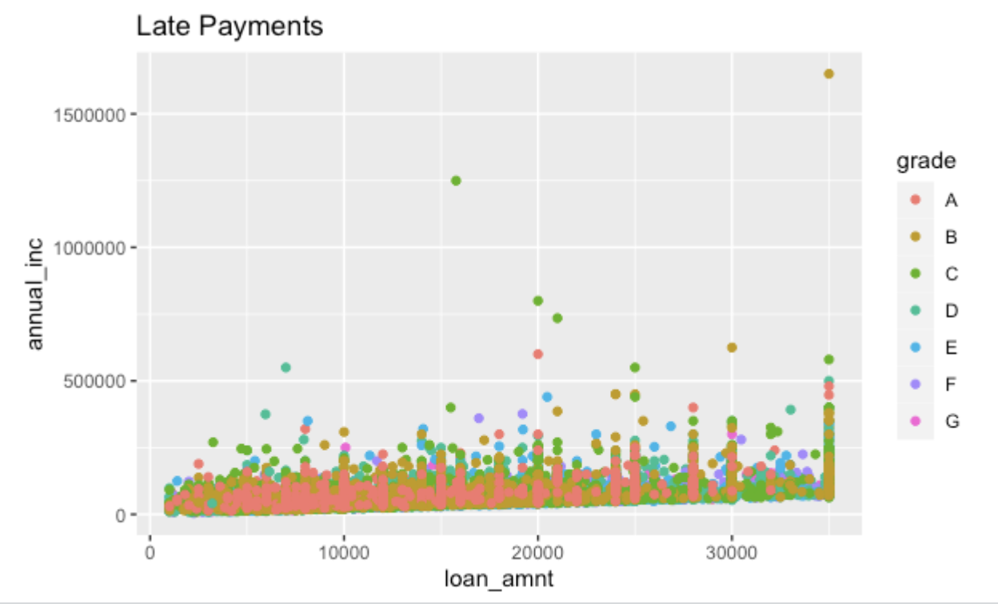
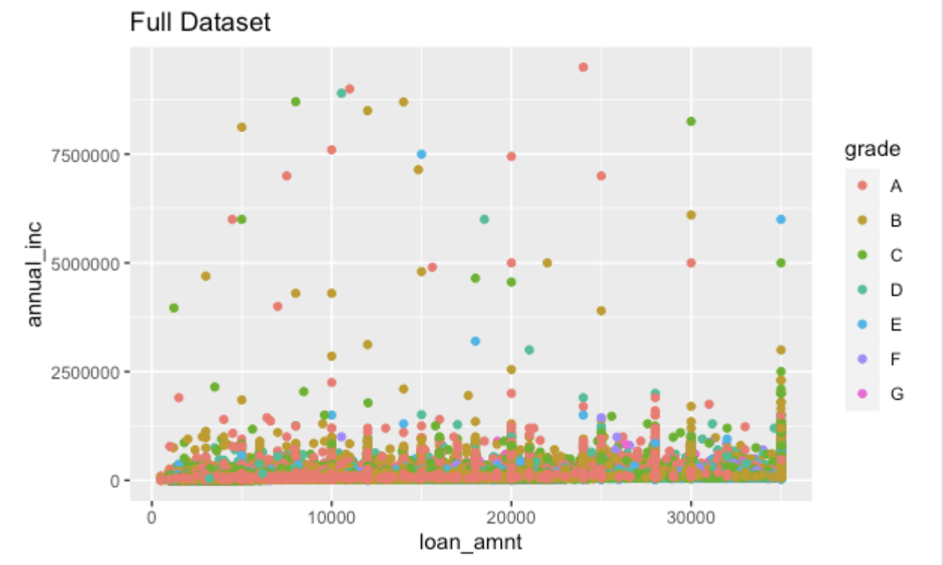
Correlation-focused EDA
R-value: 0.461185
R-value: N/A
Notes:
Isabella

Slide 21
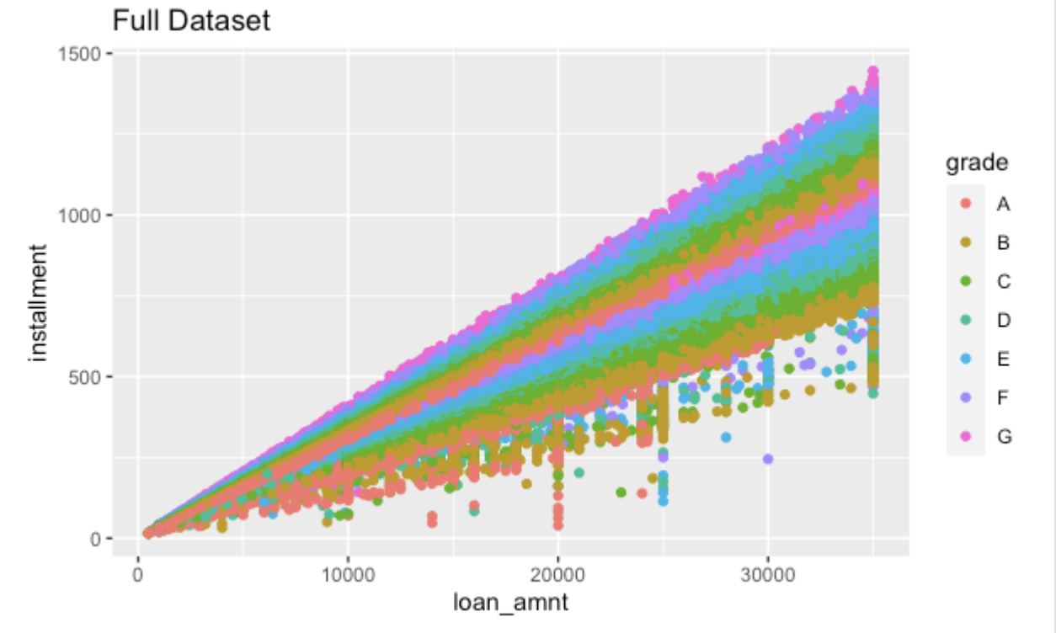
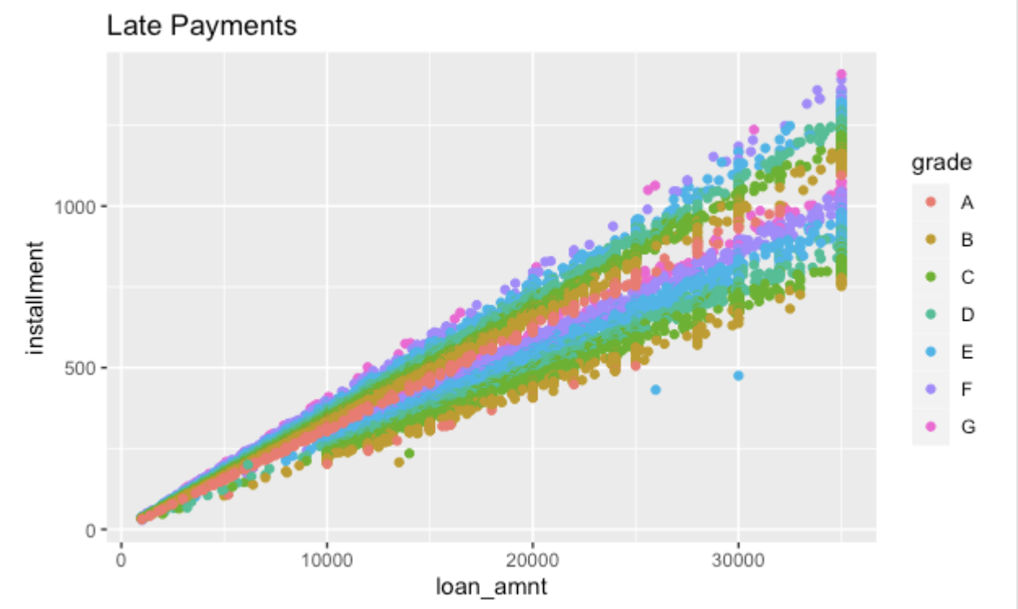
Correlation-focused EDA
R-value: 0.944823
R-value: 0.944977
Notes:
Isabella

Slide 22
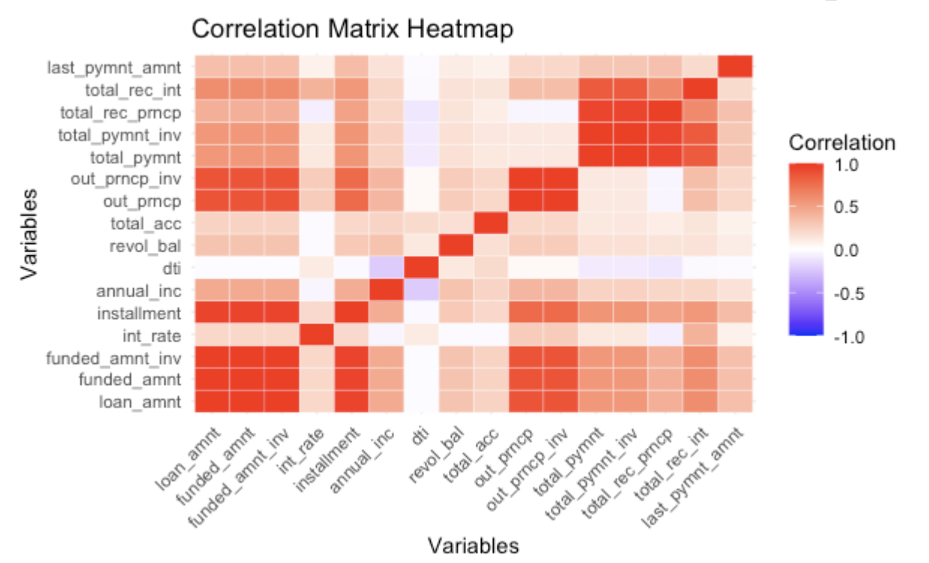
Notes:
Isabella

Slide 23
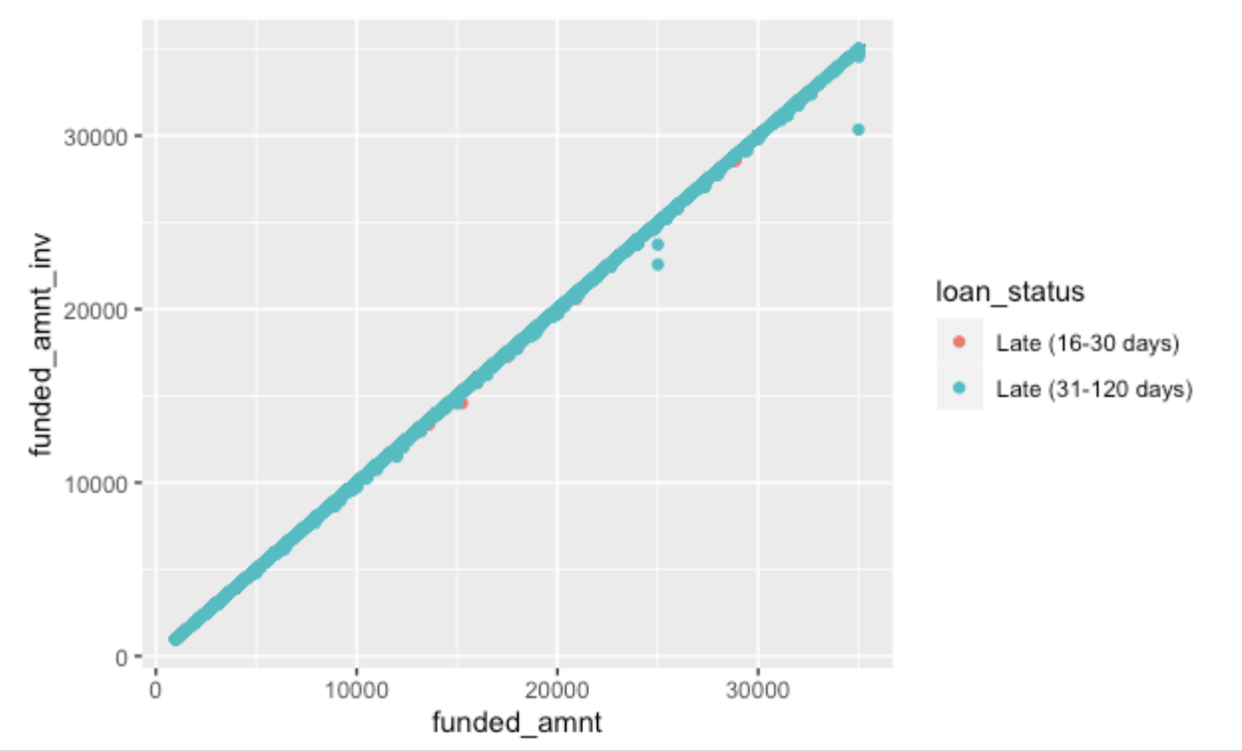
Exploring Correlations – Late Payments
R-value: 0.999881
R-value: 0.999981
Notes:
Isabella

Slide 24
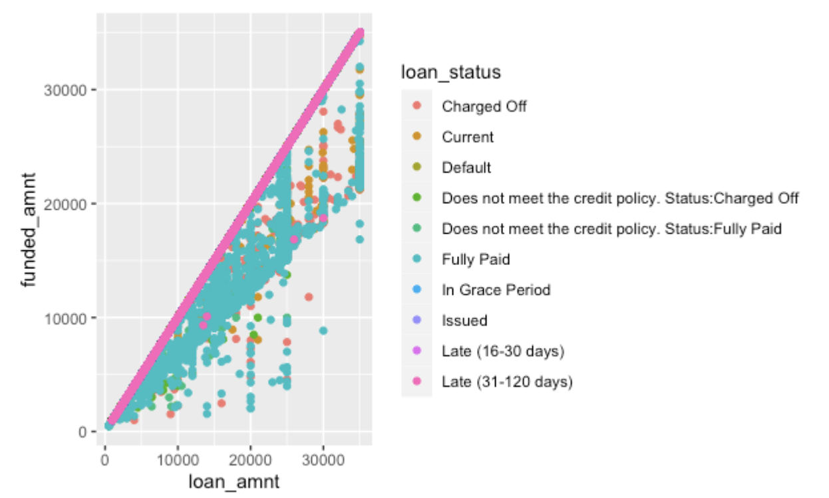
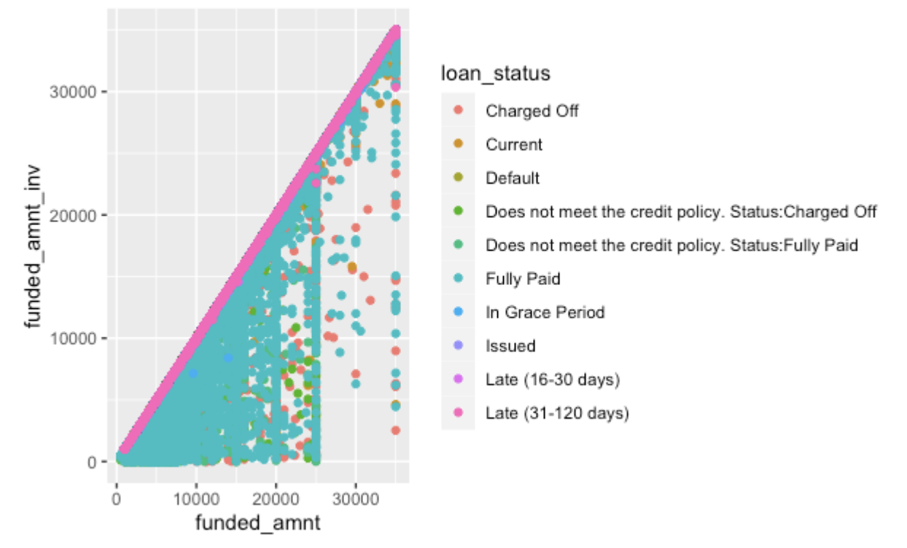
Exploring Correlations – Full Dataset
R-value: 0.999263
R-value: 0.998025
Notes:
Isabella

Slide 25
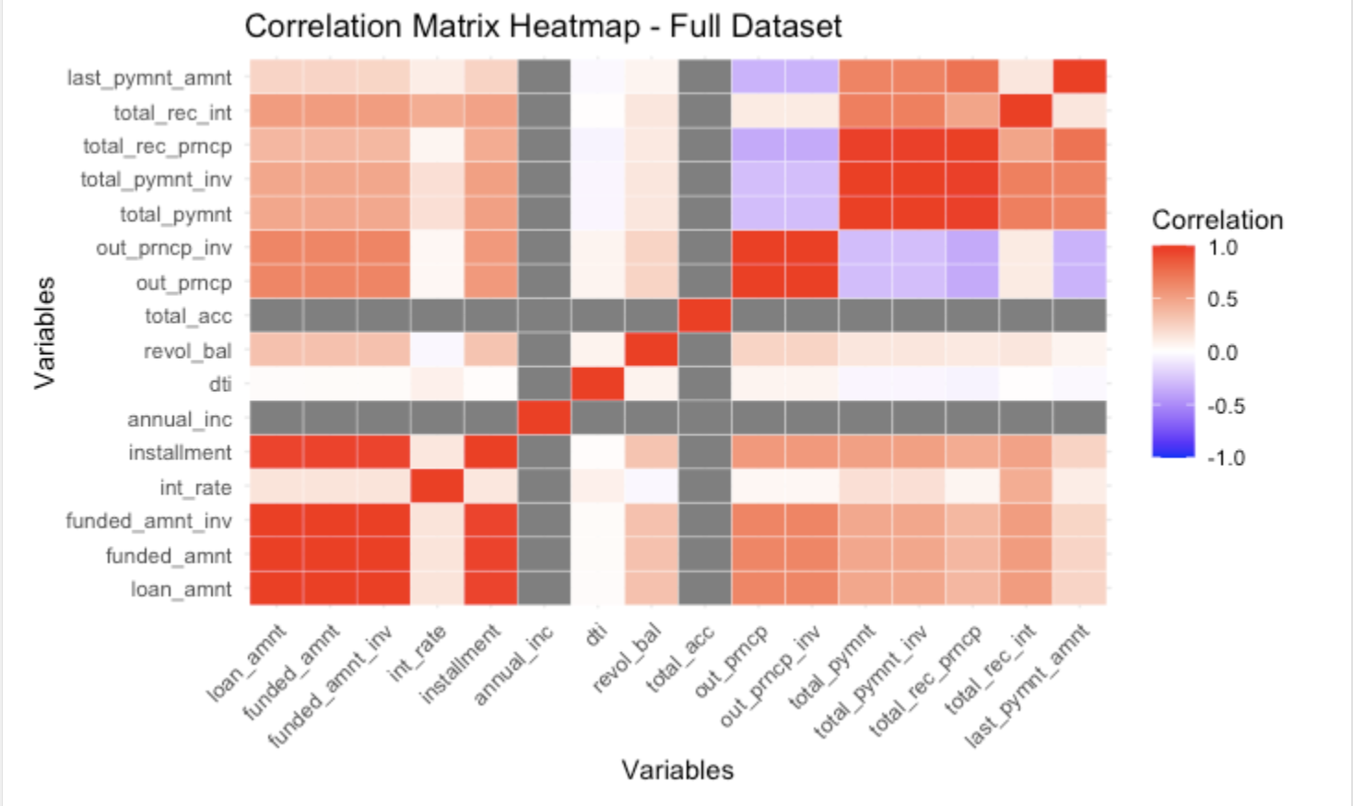
Notes:
Isabella

Slide 26
Hypothesis #3 Conclusions
The variables predicted to be similar are indeed similar for both the late payments and the full dataset.
However, the graphing indicates that the correlation is unusually strong for the late payments.
According to the R-values and the heatmap matrices, there are similar correlations between most variables between the late payments and the full dataset.
Notes:
Isabella

Slide 27
Hypothesis #4
There are subgroups we can break the data into that can help banks more accurately tell when a customer might make a late payment.
If we can find these subgroups, the bank can adjust the loan amounts as needed to cut down losses and minimize risk
Notes:
Kennedy

Slide 28
EDA
Filtering
Histograms
Narrowing the dataset to late payments
Understanding how loan status was distributed
Correcting Data Types
Ensuring the data is read properly by R
Notes:
Kennedy

Slide 29
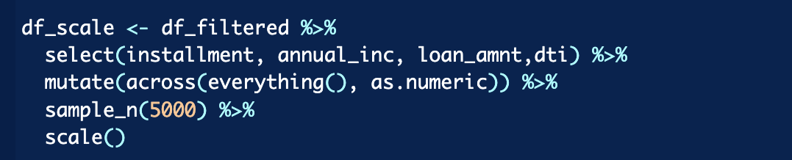
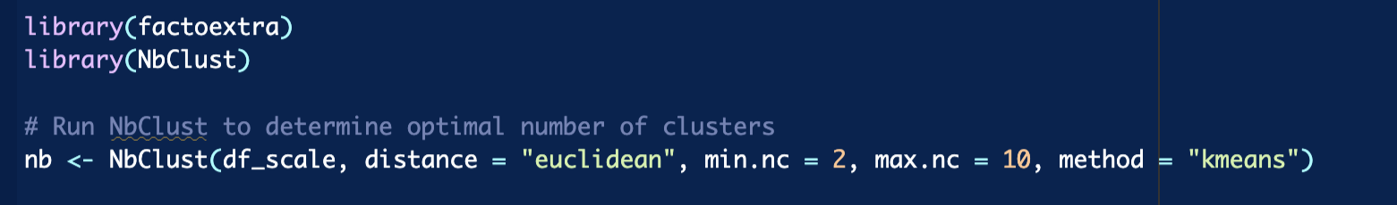
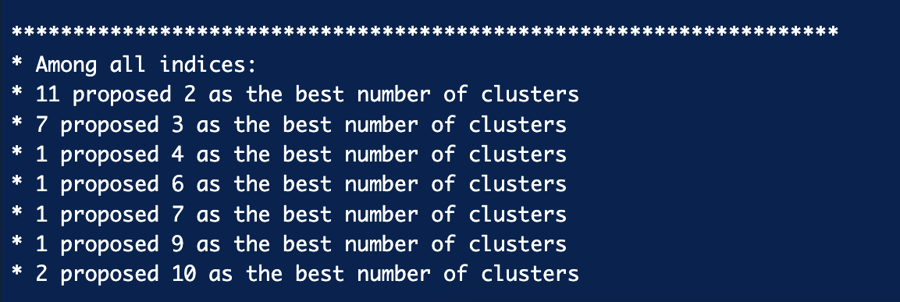
Testing
Put data into scaled matrix
Perform clustering
Analyze Output
Notes:
Kennedy

Slide 30
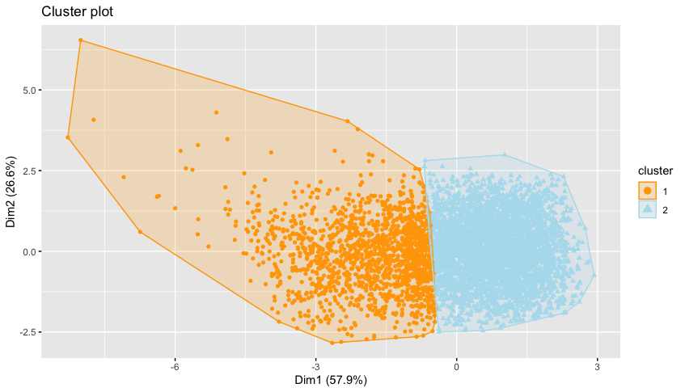
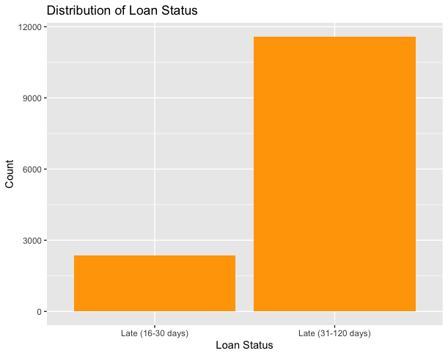
Hypothesis # 4 Conclusions
Time
Interpretation
Even with significant computing power, the clustering took on average around 15 minutes to run
The clustering confirmed what the date already showed
Notes:
Kennedy

Slide 31
Putting it all together
Team Member | Hypothesis | Rejected/Accepted
Isabella | Similar variable correlation | Accepted
Grady | Annual Income and Delinquent Accounts | Rejected
Abe | Annual Income and Interest | Rejected
Kennedy | Late payment subgroups | Rejected

Slide 32
What should the bank do?
Create key variable profiles when determining if a current loan customer will pay late:
Prioritize similar variables when examining late payments like funded amount and loan amount
Include Debt to Income ratio and add proportion of the loan currently paid column
Separate these profiles into late by 16-30 days and 31-120 days as indicated by clustering
Our best advice moving forward

Slide 33
Thank You!
Any Questions?

